Slide 1
Power Electronics Project presentation
Topic : Hybridization of PV cell and wind Energy systems
Group -2
Challa Sumanth Reddy - 2017A8PS0706H
Guduguntla Venkata Sai Sumanth - 2017A3PS0561H
Tandala luca Sai Sandeep - 2017A3PS0505H
Devi Surya Kiran - 2017A8PS0738H
Nimmagadda Bhagavath chowdary - 2017A3PS0532H
Surapaneni Zenith - 2017A8PS0671H

Slide 2
Introduction
The recent decade has seen a significant rise in the population, thereby requiring the need for higher Electrical power generation.
The use of fossil fuels pollute the Environment and also deplete natural resources.
So, in this project we focus on hybridization of Photovoltaic (PV) systems and Wind Energy (WE) systems to partially cover the electrical power demand.

Slide 3
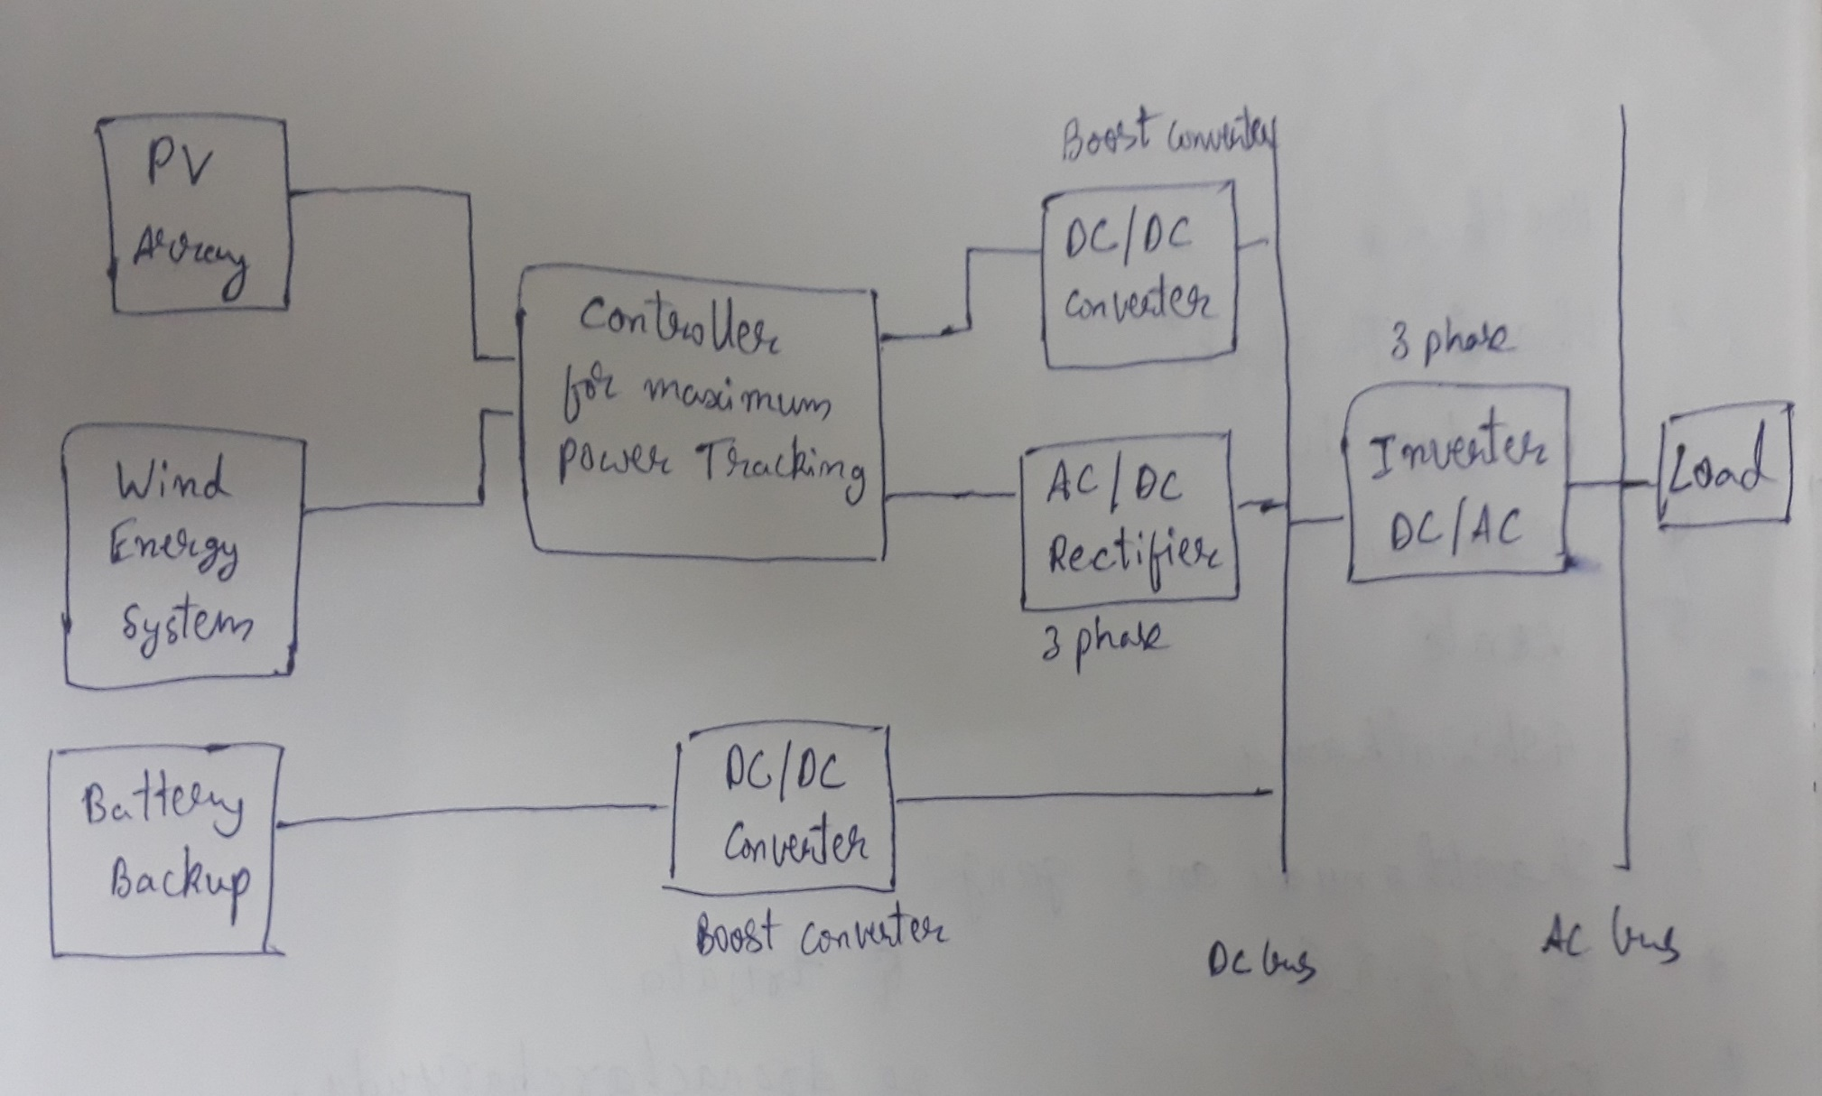
Requirements and block diagram
Photovoltaic cell Array
Wind turbine system
Battery backup
3 phase Rectifier
Boost converter
Controller for maximum power tracking
3 phase Inverter

Slide 4
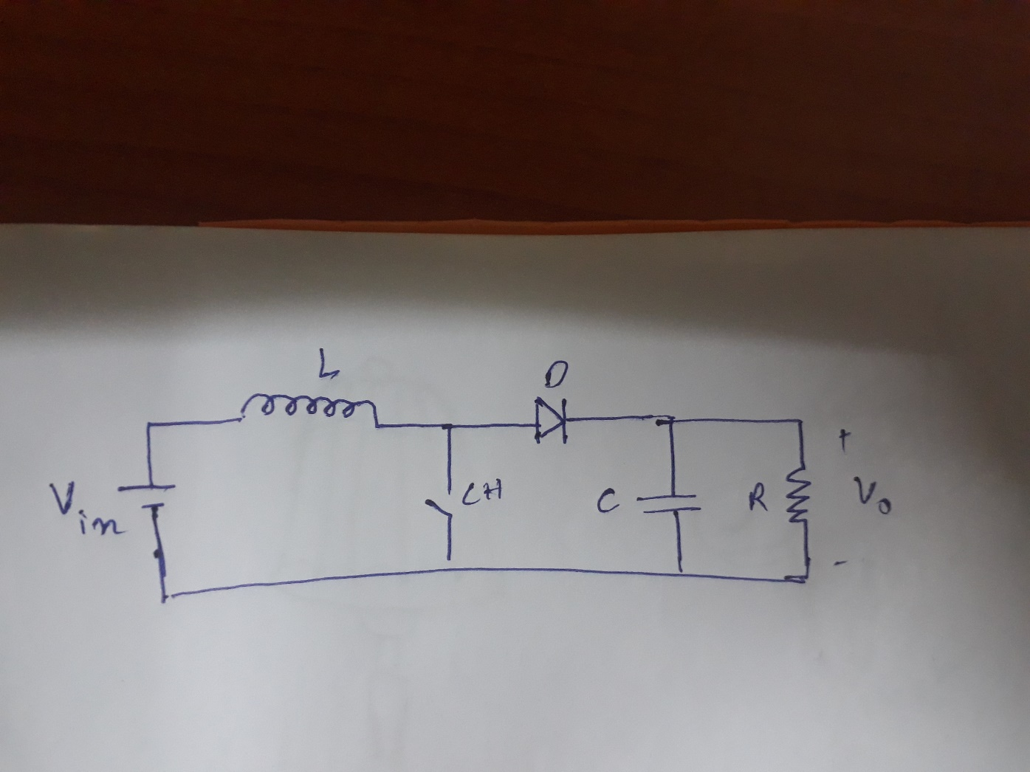
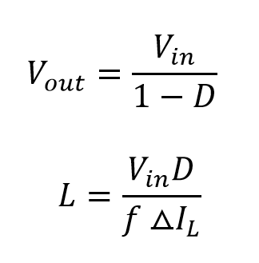
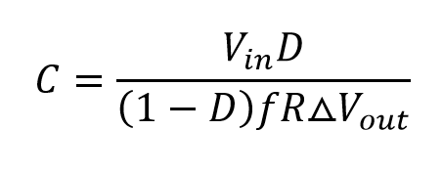
Boost Converter
A boost converter is a DC-DC converter which is used to step up the voltage.
The output voltage depends upon the time for which the switch gate is closed/open (Duty cycle).

Slide 5
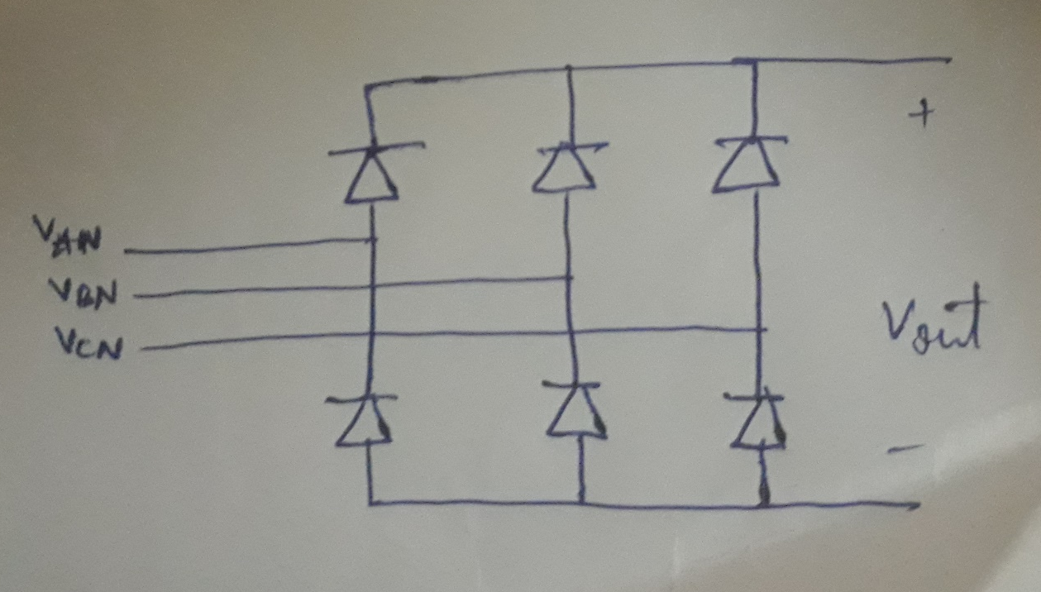
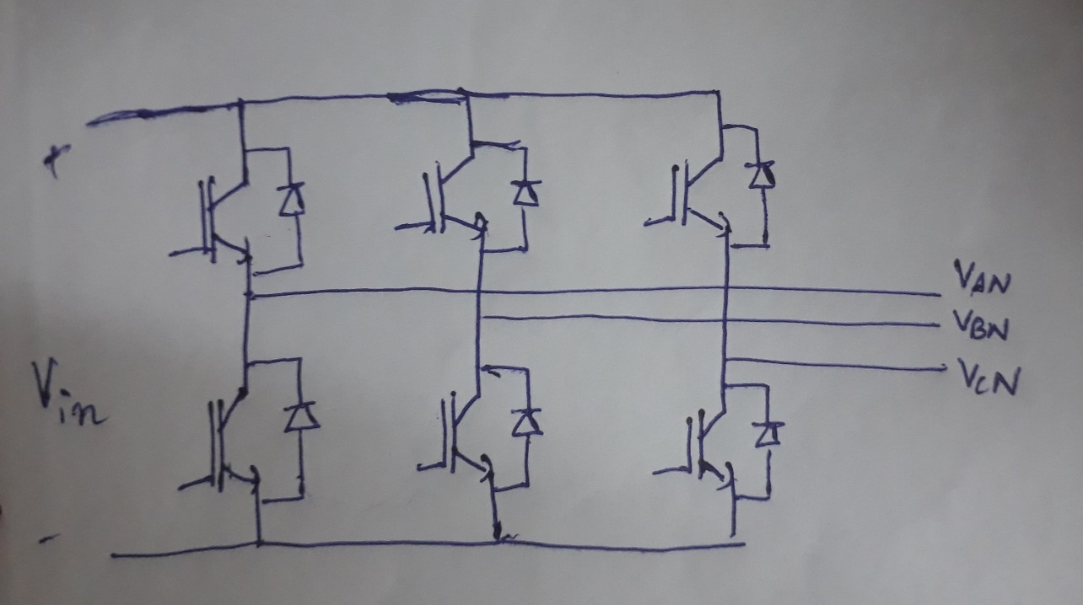
Rectifier and Inverter
A Rectifier converts alternating current (AC) to direct current (DC).
Rectifier generally uses diodes for rectification process.
An inverter in the inverse of rectifier.
An Inverter converts direct current (DC) to alternating current (AC).
Inverter generally uses IGBT for conversion.

Slide 6
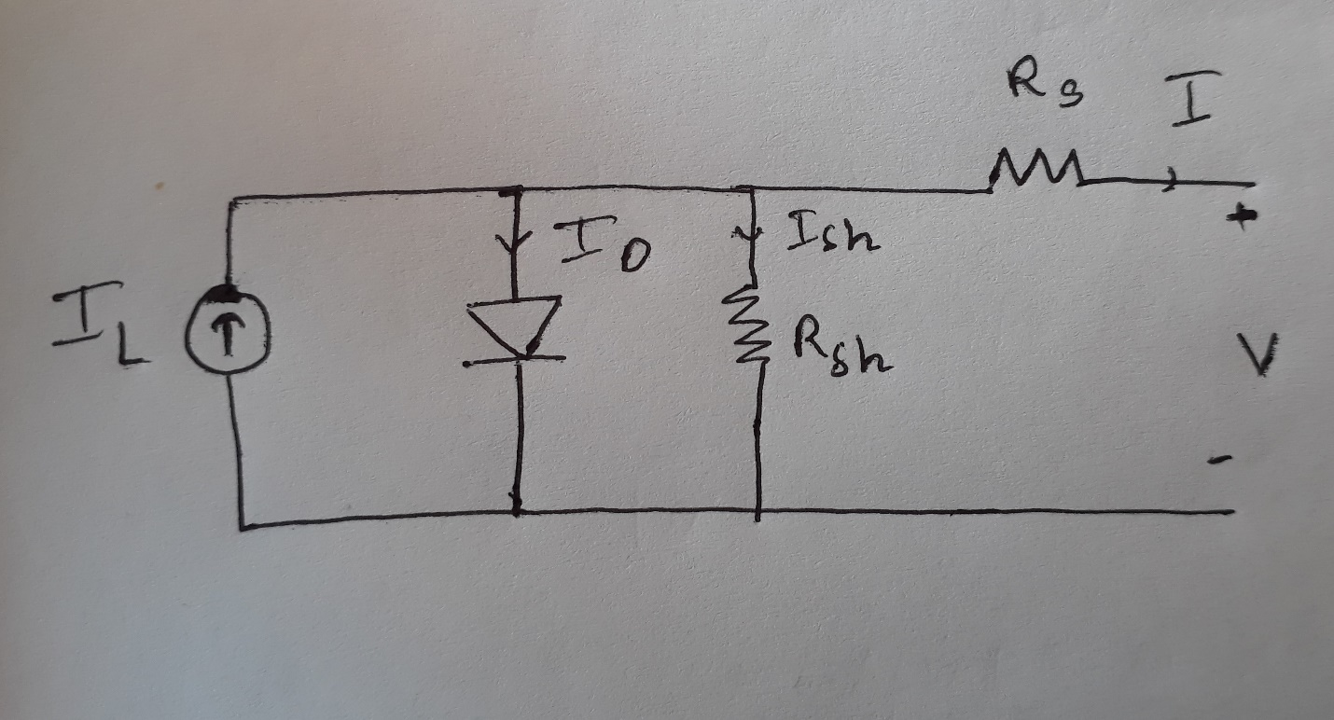
Photovoltaic cell
PV cells are basically p-n junction semiconductors which contain a photo-generated current source paralleled with a diode and a resistance and then a resistance in series with it.
Based upon the Temperature and Irradiance that is incident on the solar cell it generates the appropriate output Voltage and current.

Slide 7
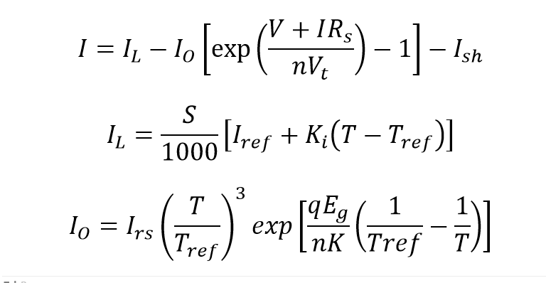
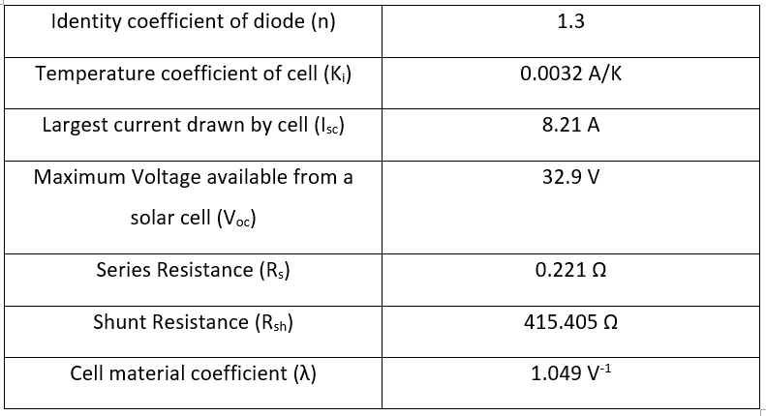
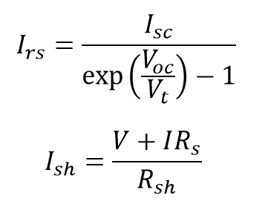
Formulas and Specifications Related to PV cell

Slide 8
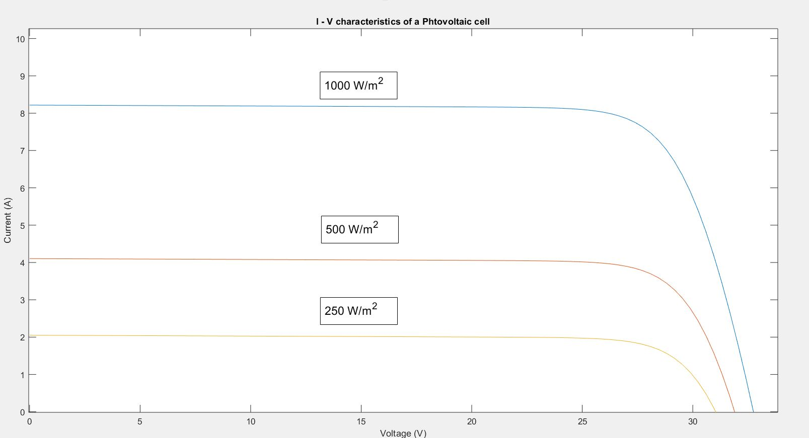
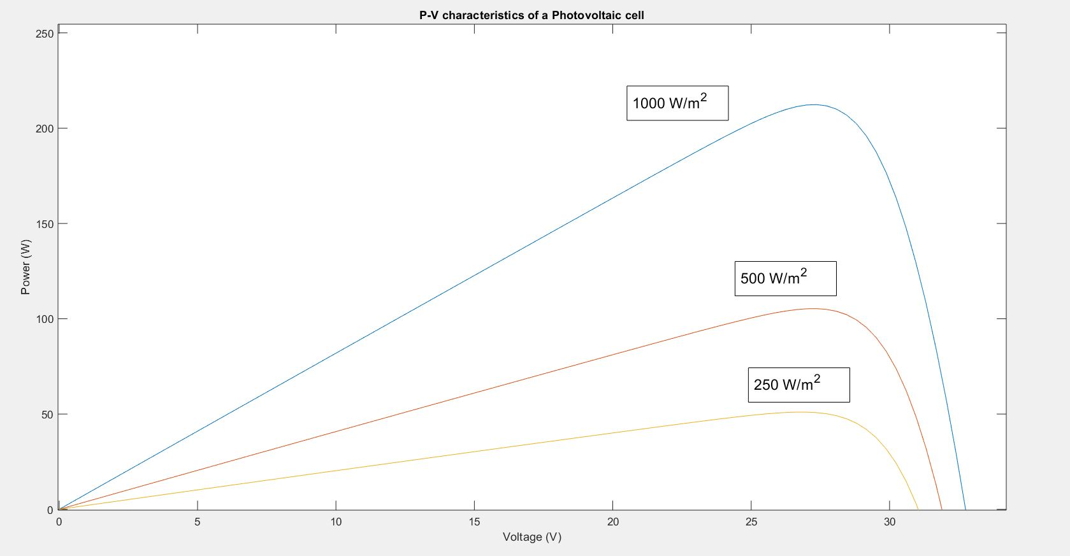
Characteristics of PV cell

Slide 9
Wind Energy system
Power generation depends on Performance coefficient of wind, density of air, Tip speed ratio, Blade pitch angle, and is largely dependent on velocity of wind.
The Wind turbine is operated when the wind speed is between the limits of cut-in and cut-out speeds.
The 3 phase AC output voltage generated is converted to DC using a 3 phase rectifier.
The output voltage can be controlled by controlling the base torque.

Slide 10
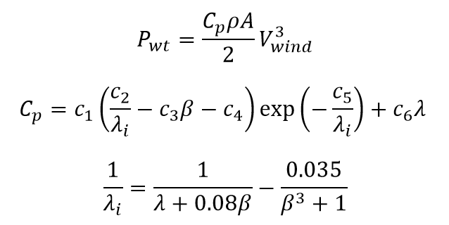
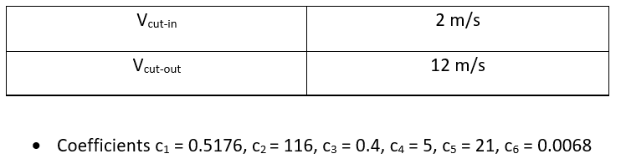
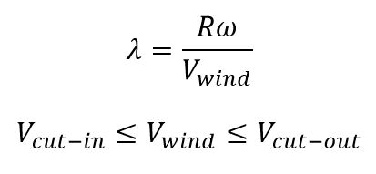
Formulas and Specifications of wind energy system

Slide 11
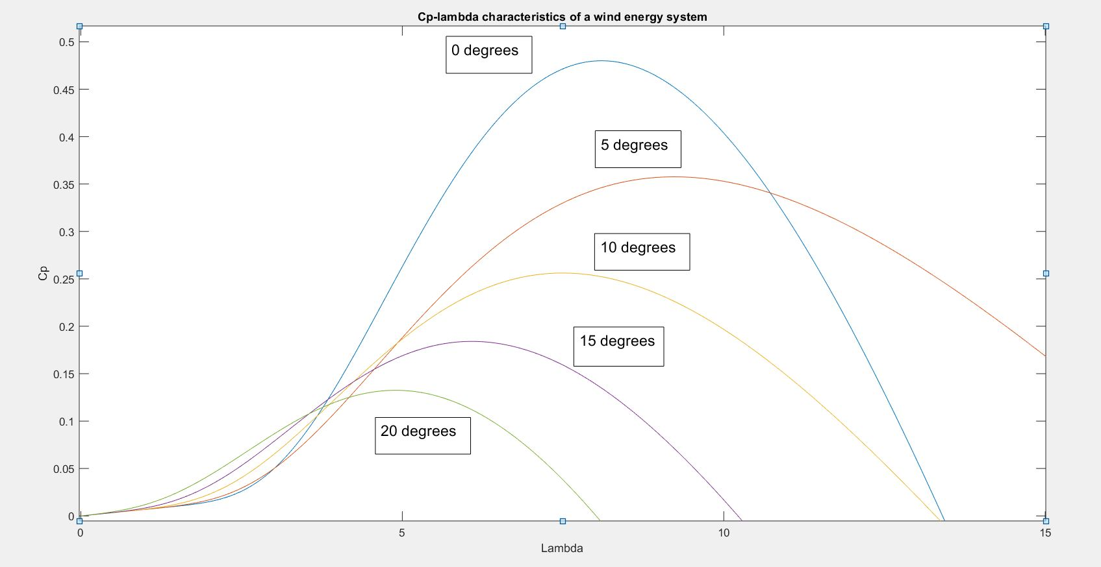
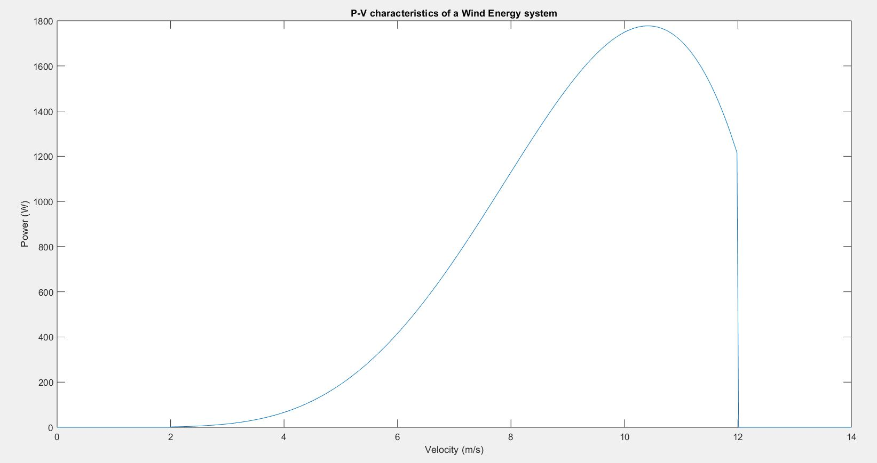
Characteristics of Wind energy system

Slide 12
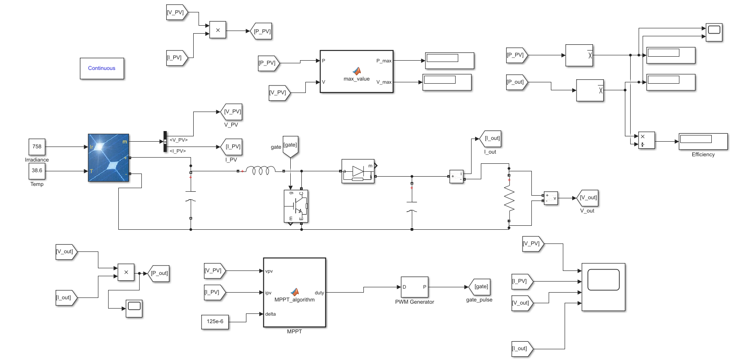
Simulink model of PV cell with boost converter

Slide 13
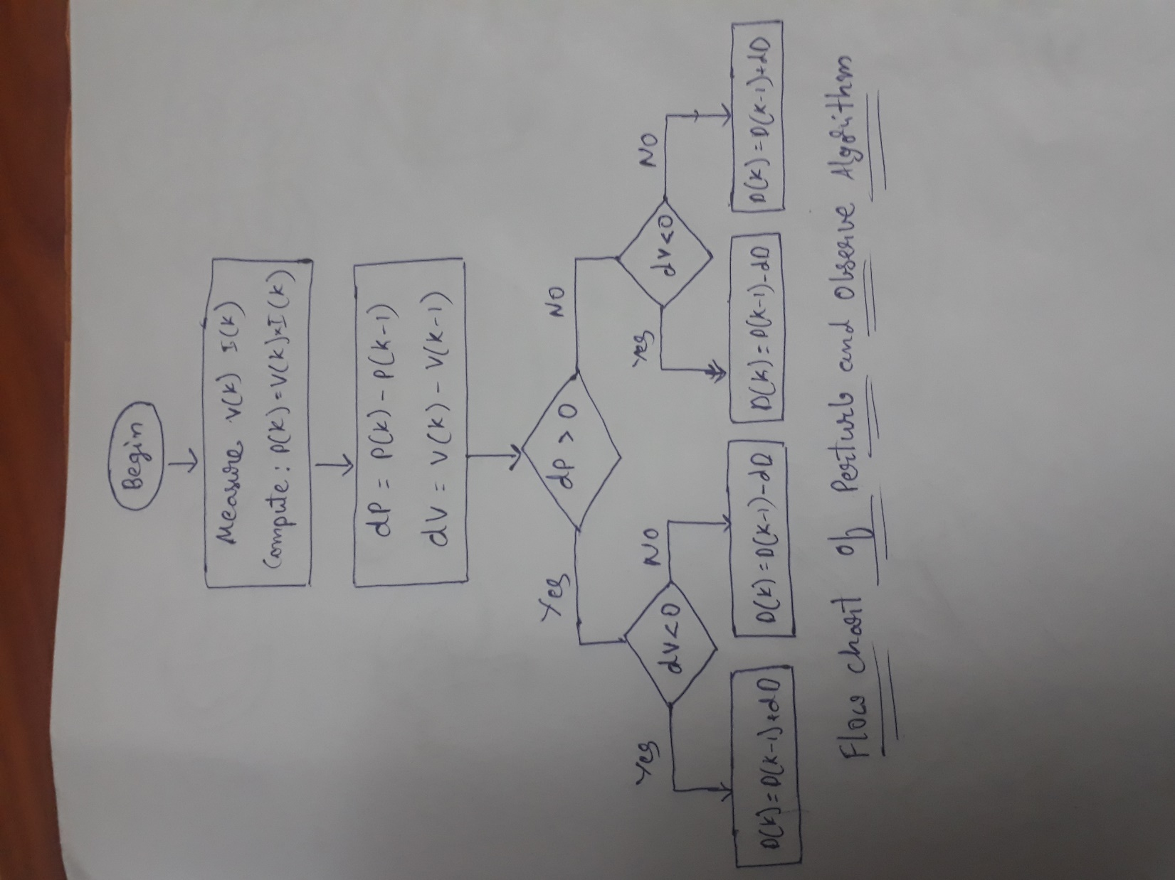
MPPT controller
MPPT controller is a maximum power point tracking controller.
It is used in case of PV cell and wind system to calculate the maximum power, find the voltage corresponding to maximum power and operate the systems at that voltage.
Perturb and observe algorithm is used to implement the MPPT controller.
The output is given to a PWM generator which is used pulse for the gate.

Slide 14
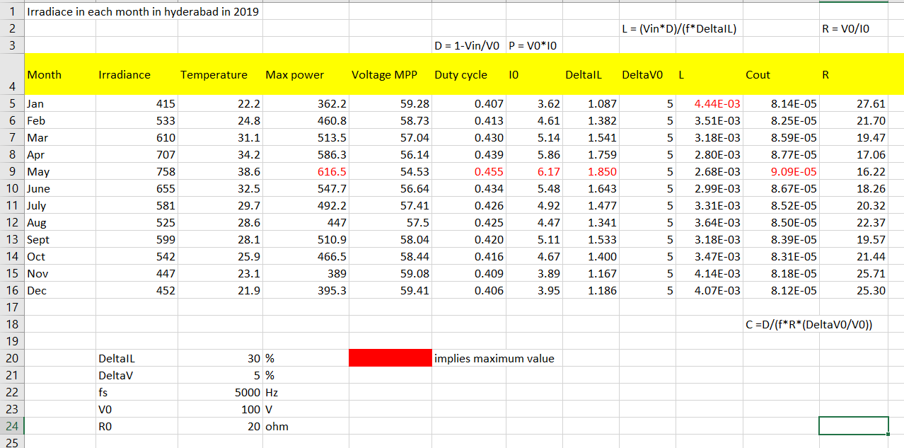
Boost converter specifications

Slide 15
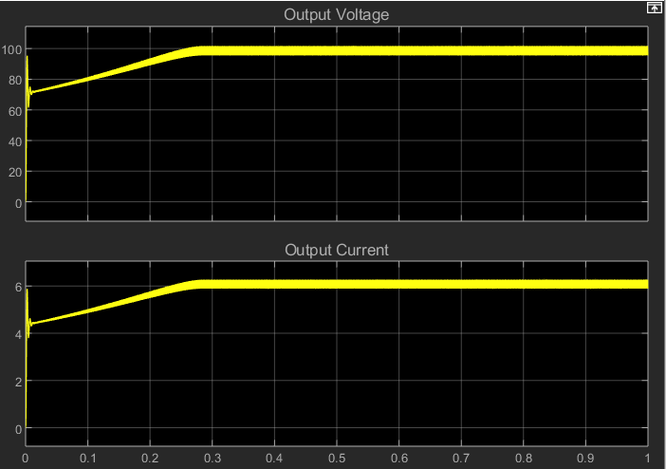
Output characteristics of PV cell with boost converter
For a temperature of 38.6 degrees and irradiance of 758 W/m^2 , we can obtain the output voltage of 100V.
The MPPT controller connected to the PWM generator is used as gate pulse.
L, C and R values are given according to the data above.

Slide 16
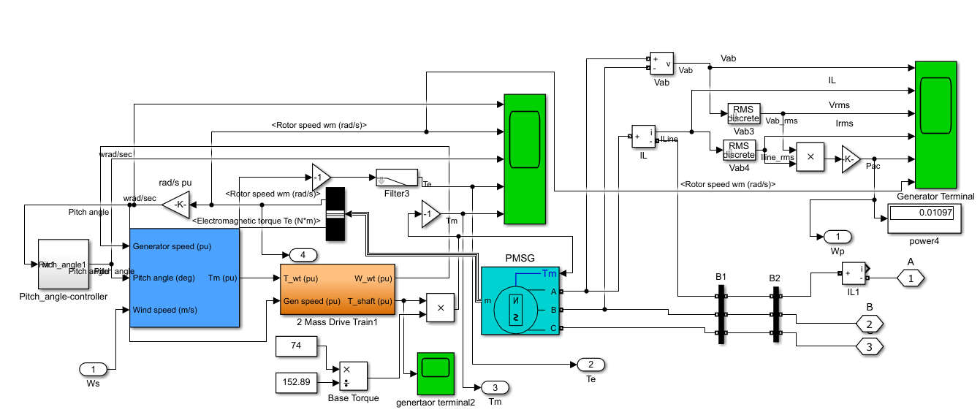
Simulink model of Wind turbine:
Wind turbine block in Simulink generally gives us the output in power.
So in order to covert this to energy, we need to take help of a motor-generator couple.
But the PMSG block helps in doing this entire conversion in one go.
This can later be rectified and given to the inverter terminals

Slide 17
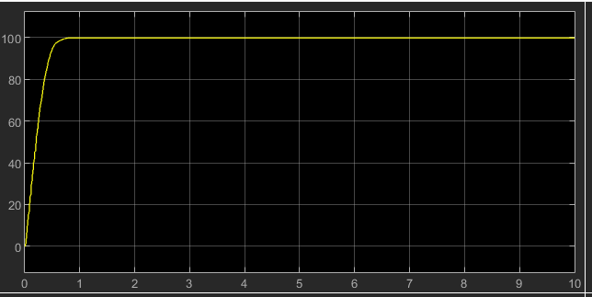
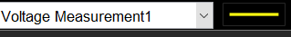
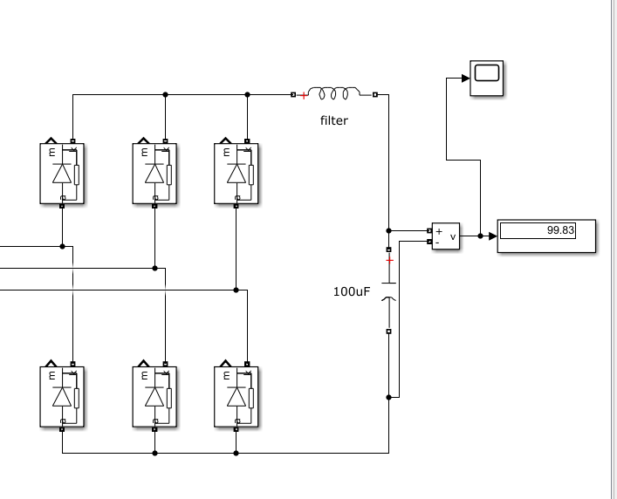
Output characteristics of wind turbine:
We considered all default, basic values for the wind energy output characteristics, like:
Wind speed is taken on an average to be 1.2 m/s.
The turbine can give an output across very high base torque also.
We chose the value such that the model could be integrated with PV cell array structure previously discussed.
Output is filtered and obtained from three phase rectifier circuit, passed through LC filter circuit(details in model).

Slide 18
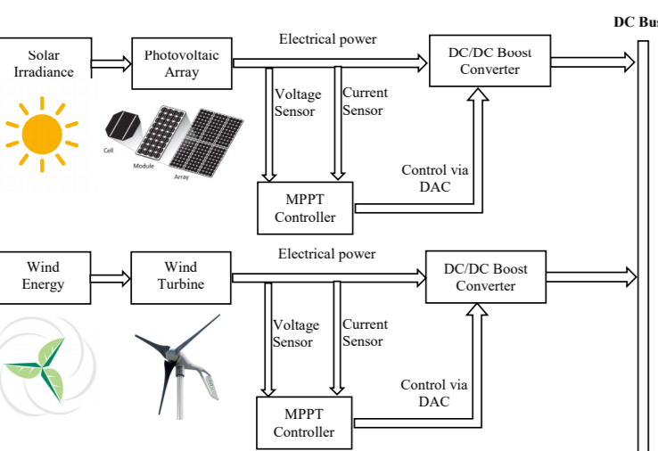
Continuing the model:
The outputs of MPPT subjected PV array and rectified wind turbine are added to voltage bus, and are connected to the DC/AC inverter.
The output from this inverter can later be used on for household applications
The model is constructed so that we can unify both the solar and wind power outputs to grid and use them for household purposes.

Slide 19
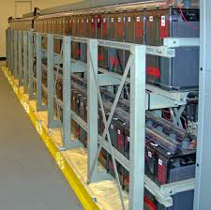
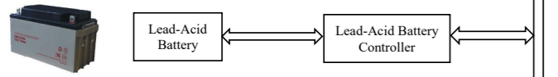
Rechargeable Battery (backup):
sometimes extra power is generated, which can’t be directly used which gets wasted if it is not stored .
So to avoid this, all the extra power generated by the model can be stored using a rechargeable battery system.
The battery can be attached to the bus, and stores the power, which could be used later whenever needed.
This model can also be linked to grid(if scaled as per needed adjustments).

Slide 20


